Slide 1
Current – Intelligent Transportation System
March 22 2012
CS410 Red Team
Where do you need to go?

Slide 2




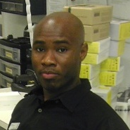

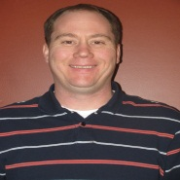
Introduction: Our Team
Nathan Lutz
- Project Manager
- Hardware Specialist
March 22 2012
Chris Coykendall
- Web Developer
- Software Specialist
Akeem Edwards
- Financial Specialist
- Software Specialist
Brian Dunn
- Marketing Specialist
Dean Maye
- Documentation
- Software Specialist
CS410 Red Team
Kevin Studevant
- Software Specialist
CJ Deaver
- Risk Analyst
Domain Expert
Kamlesh Chowdary
ITS Engineer at HRT
Domain Expert
Dr. Tamer Nadeem
Mobile Apps at ODU
Mentor
Dave Farrell
Systems Engineer at MITRE Corp.

Slide 3
Introduction: The Problem
Lack of complete information prevents transit organizations and local businesses from maximizing the potential benefits of light rail systems.
March 22 2012
CS410 Red Team

Slide 4
Background: Economy
March 22 2012
Studies show that light rail systems have a history of directly boosting local economies in three key ways:
  Increased retail sales
  New jobs and development
  Higher property values
CS410 Red Team

Slide 5
Background: Increased Sales
March 22 2012
Due to increased accessibility and an influx of new customers, local businesses in light rail service areas see increased sales:
  A study in Dallas showed a 33% increase in retail sales of businesses near the DART starter line.¹
  Near Norfolk’s Tide light rail station on Newtown Road, a 7-Eleven owner reported a 13-14% increase in sales.²
  In Salt Lake City, a restaurant owner reported annual increases of 25-30% due to their proximity to the TRAX light rail.³
  In Phoenix, one business owner reported a 30% increase in revenue since the local light rail’s opening.⁴
CS410 Red Team
http://www.detroittransit.org/cms.php?pageid=26
http://hamptonroads.com/2012/02/some-stores-near-norfolk-light-rail-stations-see-boost
http://www.gulfcoastinstitute.org/university/LightRail_BusinessImpact.pdf
http://www.friendsoftransit.org/The-Businesses-of-Light-Rail.pdf

Slide 6
Background: Jobs & Development
Over the past five years, many studies have shown light rail systems as an effective stimulant for new development and jobs:
  In Charlotte, over $291 million in new development was seen along their new 10-mile line with another $1.6 billion expected.¹
  The Maryland Transit Administration estimated 27,000 new jobs per year over the next 30 years attributed to their new Purple Line.²
March 22 2012
CS410 Red Team
Dallas LRT Projected Spending vs. Impact³
Line | Spending | Impact | Jobs
Blue Line | $289 Million | $502 Million | 3,969
Orange Line | $1.18 Billion | $2.05 Billion | 16,205
Green Line | $868 Million | $1.5 Billion | 11,921
Total | $3.14 Billion | $5.65 Billion | 32,095
http://www.detroittransit.org/cms.php?pageid=26
http://washingtonexaminer.com/local/maryland/2011/11/purple-line-expected-be-major-economic-engine-md-officials-say
http://www.dart.org/about/WeinsteinClowerTODNov07.pdf

Slide 7
Background: Property Value
Both directly through increased accessibility and indirectly through area development, property values increase from light rail systems:
  In Dallas, residential properties increased by an average of 39% while commercial properties increased by 53% over similar properties not located near the rail.¹
  A study in Portland showed an increase of over 10% for homes within 500 meters of the MAX Eastside line.²
  In Denver the poor economy led to an average market decline of 7.5% but homes near the light-rail stations saw an increase of almost 4%.³
March 22 2012
CS410 Red Team
http://www.dart.org/about/economicimpact.asp
http://www.rtd-fastracks.com/media/uploads/nm/impacts_of_rail_transif_on_property_values.pdf
http://www.denverpost.com/news/ci_10850014

Slide 8
Background: Traffic & Parking
Studies estimate that a $12.5 Billion rail system subsidy returns $19.4 Billion just through reduced congestion and another $12.1 Billion in parking.¹
  Local: By 2030, Virginia will need an estimated 989 new lane-miles to accommodate growing traffic which will cost $3.1 Billion.²
  National: Congestion and traffic cause over $115 Billion in lost productivity and wasted fuel in the US each year.³
  How? Even a reduction as small as 5% in traffic volume will reduce delays by 20% or more during peak hours.¹
March 22 2012
CS410 Red Team
http://www.vtpi.org/railben.pdf
http://reason.org/news/show/126773.html
http://mobility.tamu.edu/files/2011/09/congestion-cost.pdf

Slide 9
Background: Tide Case Study
March 22 2012
A survey of over 1000 Norfolk residents was taken and although 90% were aware of new light rail, many lacked other information:
  About 70% of downtown workers did not know the stop locations.
  About 55% of other respondents did not know the stop locations.
  69% of respondents ranked information about stops as an important problem.
  75% of respondents ranked schedule information as an important problem.
CS410 Red Team
http://www.gohrt.com/publications/reports/sir-light-rail-summary.pdf

Slide 10
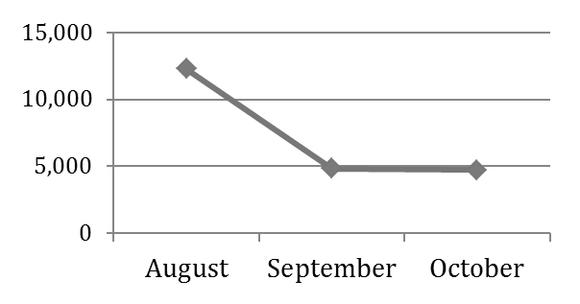
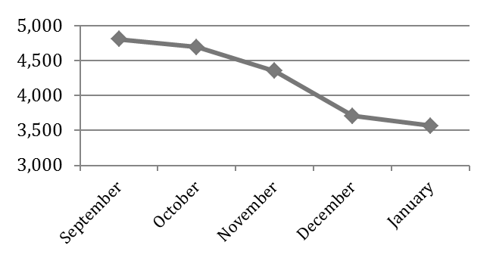
Background: Tide Ridership
March 22 2012
The Tide ridership started strong, breaking the first-year 2,900 daily rider estimate in it’s opening months, but has been in decline since.¹
CS410 Red Team
http://www.gohrt.com/public-records/Commission-Documents/Commission-Meetings/FY2012/January-2012.pdf

Slide 11
The Problem: Revisited
These studies show benefits to areas adopting light rail systems are already there, but return on investment can be further boosted in 3 key areas:
  Smoother Operation: Light rail systems have some of the lowest delay times and incidents, but little is done to mitigate problems that do occur.
  Communication: Two-way communication is essential in every aspect of improving light rail systems towards further expansion.
  End-user satisfaction: Making riders happy will ensure the future of light rail systems through customer retention and word of mouth.
March 22 2012
CS410 Red Team

Slide 12
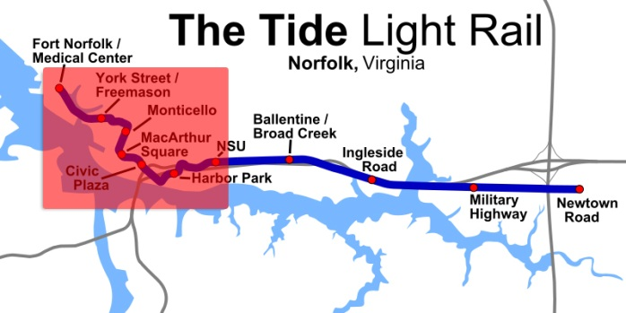
Operating Problems
March 22 2012
The Tide tracks the number of riders entering the train, but no detailed information.¹
Operators have no form of real-time alerts or status updates.²
Dispatchers have no way of tracking car positions on the downtown portion of the rail system, so must rely on radios.³
CS410 Red Team
http://www.metro-magazine.com/News/Story/2011/08/INIT-employees-to-serve-as-Tide-Guides-.aspx
http://hamptonroads.com/2011/07/control-room-nsu-serves-brains-light-rail
http://www.serpefirm.com/responsibilities-the-tide-light-rail-controller-operator.aspx

Slide 13



Rider Process Flow pre-Current ITS
-Visit Website
-Get Schedule Info
-Get Fare Info
-Get Stop Info
Purchase e-ticket
March 22 2012
Buy Ticket (if not already purchased)
Go to Stop/Station
Get on Light Rail
Ride to Next Stop
CS410 Red Team
If it is their stop
Disembark
Notes:
Riders have to figure out a lot on their own – and they have no way to know: where trains are, how many people are on them, any potential problems ahead, or events or attractions near their destination. Also, if problems occur during operation of the tide, riders are stuck waiting.

Slide 14
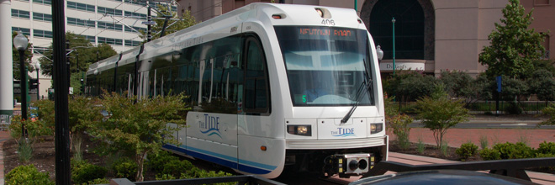

Tide Operation Process Flow pre-Current ITS
March 22 2012
Begin Service
Go to next stop/station
Pick up / Drop off
Riders
Reach End of Service
APC
Problem Occurs
CS410 Red Team
Radio Control Center for advisement
Sent to Maintenance Facility
Notes:
Currently, the tide itself is dumb – not aware of the riders around it, or on it except as a daily total. When problems occur, the riders are SOL – the tide operator will have to coordinate over hand radio to resolve the issue, with no options for rerouting of passengers

Slide 15

HRT Process Flow pre-Current ITS
Need to evaluate & expand Tide Light Rail Services
March 22 2012
Receive user feedback about service through traditional means
Static ridership data
Set Schedule, Stops/Stations and fare for Light Rail, determine new service areas
CS410 Red Team
Light Rail normal operation
Notes:
Hrt wants to make informed decisions, and they want to adapt quickly – but they cant. There is no realtime stream of data letting them know when and where trains are used the most, and no real way to account for special events that affect ridership levels. Also lack of historical data could lead to improper analysis

Slide 16
End-User Problems
March 22 2012
The Tide riders lack access to real-time information, which is a cost-effective measure that can reduce perceived wait times by an average of 10%.¹
No real-time or direct alerts and updates regarding service status and service interruptions.²
No easily obtainable information regarding local businesses near stations.
CS410 Red Team
http://www.sciencedirect.com/science/article/pii/S0965856406001431
http://www.gohrt.com

Slide 17
The Solution
March 22 2012
Current
Intelligent Transportation System (ITS)
Our product will provide accessible, real-time, and accurate information through transit authorities to maximize adoption and expansion of emerging light rail public transportation systems.
CS410 Red Team

Slide 18
Current ITS Features
March 22 2012
Real-time tracking information
Automated alerts
Direct end-user communication
Accurate historical data
Rider feedback
Event management
Local destination integration
Flexibility & scalability
CS410 Red Team

Slide 19
Tracking & Alerts
March 22 2012
GPS tracking will finally enable real-time updates on the location of rail cars through station signage, websites, and mobile apps.
Trends and historical data will entice new riders through display of high on-time percentages and accurately predicted travel times.
Real-time status updates and alerts will help mitigate the impact of service interruptions and delays.
CS410 Red Team

Slide 20


Rider Process Flow with Current ITS
March 22 2012
Use Current ITS
Get on Light Rail
Go to Stop/Station
Ride to Next Stop
CS410 Red Team
If it is their stop
Disembark
Notes:
Riders will know from step 1: where trains are, where stations are relative to them, how full they are, what businesses and attractions are at the endpoints, and they can buy a ticket.
There will be no issues if problems occur, because they will be advised on a the proper route to take by Current ITS

Slide 21
Tide Operation Process Flow with Current ITS
March 22 2012
Aware of:
-Trains
- Problems
- Riders
Go to next stop/station
Pick up / Drop off
Riders
Reach End of Service
Problem Occurs
CS410 Red Team
GPS
APC
Begin Service
Current alerts all users including HRT
Sent to Maintenance Facility
Notes:
Now, with Current ITS, the train operators know positions of trains around them, riders waiting at stations, and potential problems ahead. They can have accurate data on occupancy down to the minute. Communication between rider and tide operator, and between tide operator and HRT becomes easy.

Slide 22


HRT Process Flow with Current ITS
Need to evaluate & expand Tide Light Rail
March 22 2012
Receive user feedback about service through traditional means
Realtime ridership data
Realtime GPS data
Historical
Data
Event
Data
More accurately set Schedule, Stops/Stations and fare for Light Rail
CS410 Red Team
Efficient Light Rail
operation

Slide 23
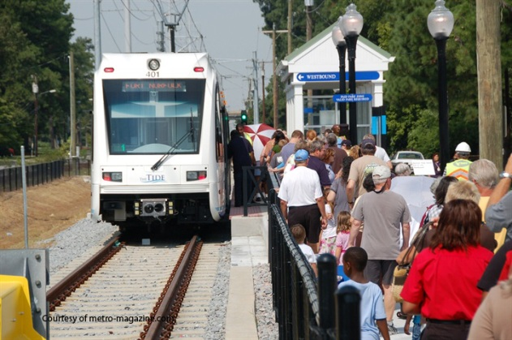
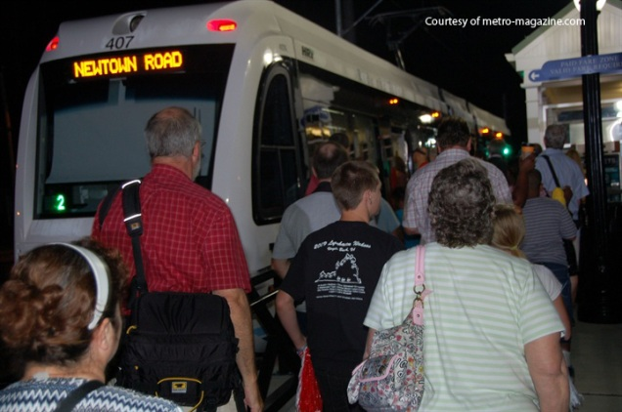
Event Management
March 22 2012
The Grand Illumination Parade resulted in almost 3x the amount of riders on The Tide on November 20th.¹
Using our project, The Tide will be able to promote the light rail service to attend these events without parking and traffic hassles.
Event management will determine when exceedingly high loads should be expected, so that they can be handled smoothly.
CS410 Red Team
http://www.gohrt.com/public-records/Operations-Documents/Rail/Monthly-Ridership/Rail-Ridership-Current.pdf
http://www.metro-magazine.com/News/Story/2011/08/Va-s-The-Tide-opens-hits-30K-boardings.aspx

Slide 24
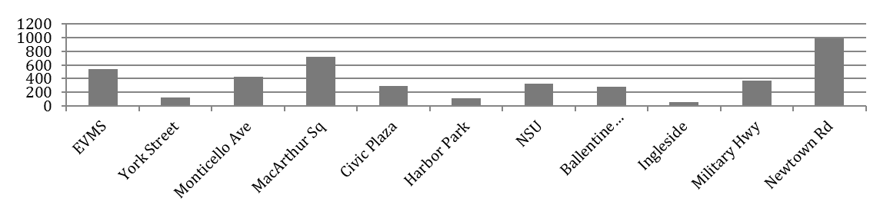
Destination Index
March 22 2012
Light rail systems provide a huge boost to local economies, but only if customers know about the businesses near stations.
Two-way communication about boarding and destinations will allow local businesses and HRT to maximize the potential gain.
Using our mobile app and website platform, users can search for points of interest and attractions to receive travel information.
CS410 Red Team
Average Daily Boarding ³
http://www.realtor.org/wps/wcm/connect/212699004205f031b404fcc7ba2f3d20/cpa_transport_090.pdf
http://hamptonroads.com/2012/02/some-stores-near-norfolk-light-rail-stations-see-boost
Debbie Messina, “The Tide.” The Virginian-Pilot. February 18th, 2012.

Slide 25
Our Current market?
March 22 2012
As traffic, gas prices, and pollution rise, light rails are quickly catching on as a more efficient means of transportation.¹
As the result of Obama investing $8 Billion in stimulus funding for rail transit, even more projects are now under development and expansion.¹
New light rail development and expansion costs millions to taxpayers who demand quick results for their money.²
CS410 Red Team
Light Rail Project Costs
Baltimore | Buffalo | Camden | Charlotte | Cincinnati | Denver | Detroit
$400 Million | $636 Million | $604 Million | $350 Million | $750 Million | $118 Million | $494 Million
Miami | Indianapolis | Portland | Sacramento | Salt Lake City | Minneapolis | Oakland
$340 Million | $498 Million | $214 Million | $176 Million | $300 Million | $548 Million | $320 Million
http://www.cbsnews.com/8301-503544_162-4949672-503544.html
http://www.lightrail.com/projects.htm

Slide 26
Market Outlook
March 22 2012
Initial Target:
- The Tide (Hampton Roads Transit)
US Market:
- 35 Light Rail systems currently active and running¹
- 60 more systems in development or proposal stages²
Global Market:
- Almost 8000 miles of Light Rail track in Europe alone (some perspective: LA to NY is less than 3000 miles)³
- Light Rails are used throughout the world from South America to the Philippines
Future:
- Global Light Rail market estimated at $7.5 Billion by 2015 and is rapidly growing.³
CS410 Red Team
http://apta.com/resources/statistics/Documents/Ridership/2011-q3-ridership-APTA.pdf
http://www.lightrailnow.org/success2.htm
http://www.prweb.com/releases/light_rail/light_rail_transit/prweb4253534.htm

Slide 27
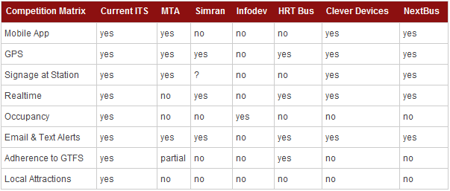
The Competition
March 22 2012
CS410 Red Team

Slide 28
Hardware
March 22 2012
CS410 Red Team

Slide 29
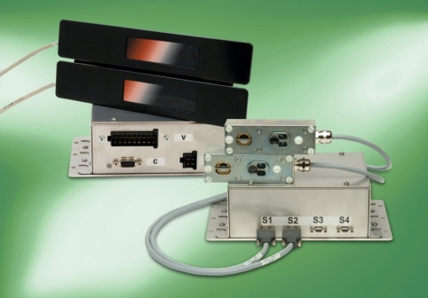
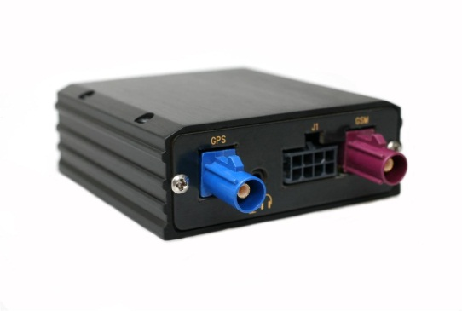
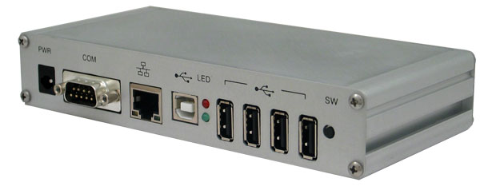
Onboard Hardware
Onboard Master PC
Underlying Hardware:
  ARM Single Board Chipset
  Linux OS
  Easily adaptable to existing AVL or APC installations
  802.11 / GPRS Capable
Designed to interface with any onboard AVL units and APC units
  Serial RS-232 & RS-485
  Long range RF
  USB
Automatic Vehicle Location (AVL)
GPS (Global Positioning System) Unit
  Reports location of train in real time
  Communicates with onboard Master PC
Automatic People Counting (APC)
Bi Directional Infrared Sensor Bars
  Accurately records occupancy by tracking incoming and outgoing passengers
  Communicates with onboard Master PC
March 22 2012
CS410 Red Team
Image source: Numerex
Image source: INIT systems
Image source: Technologic Systems

Slide 30
Server Hardware
Database server
  Large storage capacity
  Redundancy & Backups
Web App Server(s)
  Optimization & Decision engine
  Clustered & Load Balanced w/ HA
March 22 2012
CS410 Red Team
Server | Database | Optimization | WebApps
Virtual (Hosted by them) | $5000 License per VM | Resides with WAE (included in cost) | $3000 License per VM
Virtual (Hosted by Us) | Priced by CPU time¹ | Priced by CPU time | Priced by CPU time
Physical (Hosted by them) | Quoted at $6000 | Resides with WAE (included in cost) | Quoted at $4000 per node
1) Source: http://aws.amazon.com/ec2/pricing/

Slide 31
Hardware Costs
The Good News
  A lot of the equipment needed for this project our customers(HRT) already have:
    INIT Infrared Door Bar Sensors
    INIT Master Control PC
  Vendor average $170 per GPS unit ($1530 to outfit every Tide car)
  Remaining hardware cost will be server related.
    Physical Server- $10,000 one time vs. Virtual Server - $3000/yr (with Amazon EC2)
    Backups
    Networking
March 22 2012
CS410 Red Team
Notes:
The 3000 dollar figure comes from 2 Medium utilized Large instances with 1 yr term. These are $640 up front and $.096 / hr. This changes to 1000 up front and .076 for the 3 yr term

Slide 32
Software
March 22 2012
CS410 Red Team

Slide 33
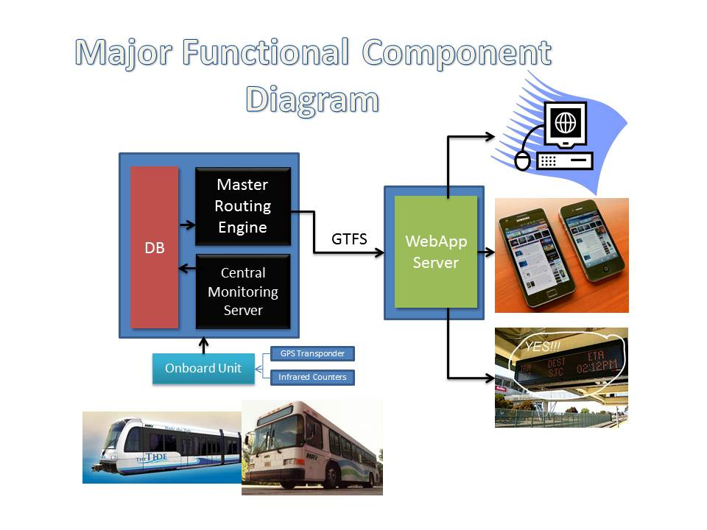

March 22 2012
CS410 Red Team

Slide 34
Software Design Concept
Emerging light rail systems may be equipped with some of the AVL functionality of our system currently.
The monitoring system will have a modular design such that existing systems/sensors on the vehicles can be interfaced into our on-board Linux embedded module.
Data is collected from the vehicle sensors and our software interprets that data.
March 22 2012
CS410 Red Team

Slide 35
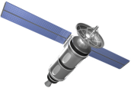
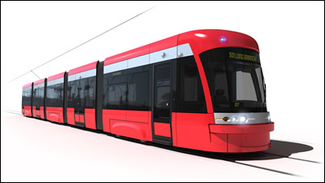
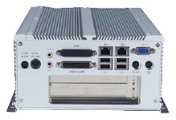
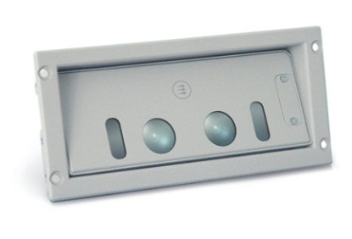
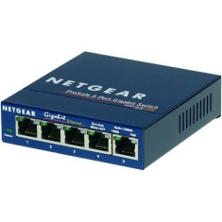
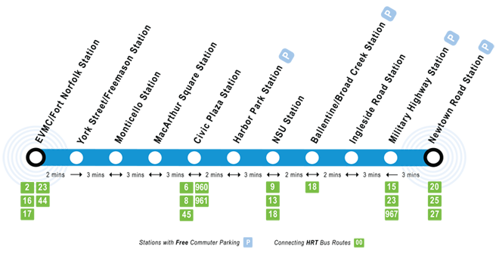
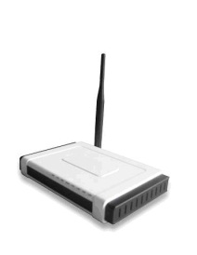

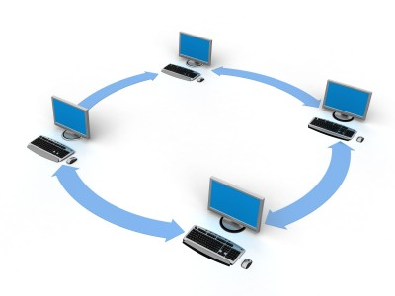
Software Phase I – Embedded System
On-Board Linux Module
w/ Wireless NIC
GPS
Light Rail Vehicle
March 22 2012
Switch
APC
CS410 Red Team
SQL Server Database
Intranet
Wireless AP Network
Notes:
The data collected from the sensors are interpreted by the embedded Linux application, then transmitted via secure 802.11 to Wireless APs along the tracks.
The AP nodes will be connected to the transit authority local Intranet.
Monitoring information is saved into a SQL database.

Slide 36

Software Phase II - Prediction
Real-time ridership and GPS coordinates of the vehicles will be retrieved from database, along with historical ridership data.
This data will be analyzed based upon various features of time, riders, waypoints and other trends.
The prediction server will generate and save a forecast to a database, as well as option routes in the event of a failure
SQL Database Server
March 22 2012
CS410 Red Team
Optimization & Prediction
Server
Notes:
Calculations are performed using supervised machine learning algorithms (artificial neural network, gradient descent, etc.)
to provide optional routes and anticipate scheduling deviation. Actual data and predictions will then be made available for the next software phase.

Slide 37

Software Phase III - Reporting
The Web Application Engine (WAE) transmits the monitoring results from the prediction server to the Google API using General Transit Feed Specification (GTFS).
Simultaneously, the WAE checks with the Google API to update its record of local destinations at the station waypoints from Google Places.
March 22 2012
CS410 Red Team
Internet
Optimization & Prediction
Server
Web Application
Engine
Notes:
On scheduled intervals, the Web App Engine updates the record of local businesses and transmits the most recent information to the Internet.

Slide 38
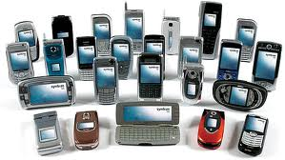
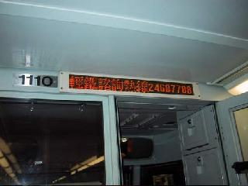
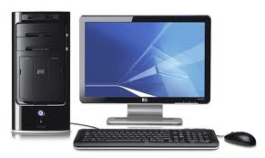
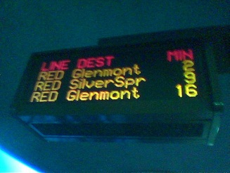
Software Phase IV - Presentation
With the WAE in place and our extensible interface to it, any web-enabled device can then retrieve the monitoring and local destination results directly using a standard format (GTFS, AJAX, etc.)
The WAE will also receive rider feedback input from the end-user devices (website , Android app, etc.) Results will be written to a database for trend data and accessible via a back-end monitoring interface.
Ideally, the real-time passenger information (RTPI) will be available at every point possible to the end-user.
March 22 2012
CS410 Red Team
Internet
Web Application
Engine
Notes:
Once the web server is in place, the sky is the limit.
Our customers will be able to monitor their passengers using an administration interface for displaying forecasted and real-time data.

Slide 39
Software Overview
PHASE I
PHASE II
PHASE III
PHASE IV (ASYNCHRONOUS)
Google API
March 22 2012
GPS
Database
Server
On-board
Module
Wireless Sensor
Network
Intranet
Optimization and Prediction Server
Web Application
Engine
APC
CS410 Red Team
Internet
Smart Devices
Desktop
On-Board
Passenger
Display
Station Display
Notes:
Here is a bird’s eye view of the overall software design phases.

Slide 40
Software Provided
Web Application Engine
- Monitoring Report System
- Capacity/Trend Forecasting
- Rider Web Interface
Optimization/Prediction Server
Embedded Linux Transmission Application
Android Application
March 22 2012
CS410 Red Team

Slide 41
Software Costs
Given data on similar Intelligent Transportation Systems deployed within the past 8 years, software costs for our system may range roughly between $80,000 and $150,000 USD.
Due to the modular nature of our system, many components may not be needed depending on the client’s specific needs.
March 22 2012
CS410 Red Team
Source: http://www.itscosts.its.dot.gov/its/benecost.nsf/images/Reports/$File/Ben_Cost_Less_Depl_2011%20Update.pdf

Slide 42
Project Risks
March 22 2012
CS410 Red Team

Slide 43
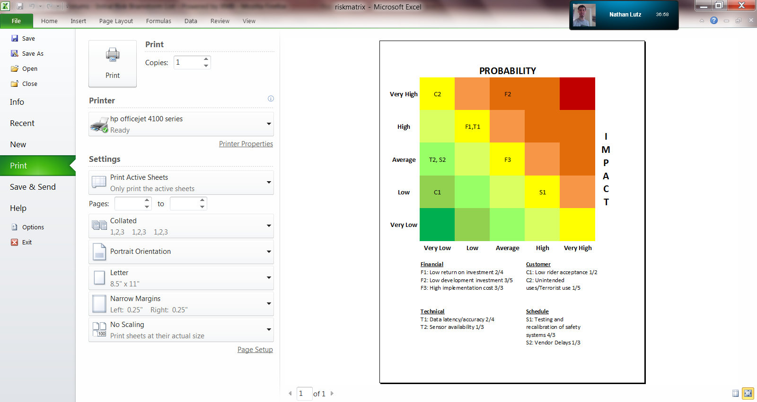
Risk Matrix
March 22 2012
CS410 Red Team

Slide 44
Financial Risks
Low return on investment 2/4
  Risk: Income from service changes and improved ridership not enough to provide an investment return.
  Risk Strategy: Provide advertising capability within web/phone application to local businesses providing an additional income source.
Low development investment 3/5
  Risk: Transportation authorities have little to no budgeting for development.
  Risk Strategy: Assist in locating and applying for transportation grants.
High implementation cost 3/3
  Risk: Implementing a full system has high initial costs. ~$800,000
  Risk Strategy: Implement system in smaller increments to defer costs.
March 22 2012
CS410 Red Team

Slide 45
Customer Risks
Lack of interest by transit authorities 2/4
  Risk: Transit authorities feel current systems are efficient
  Risk Strategy: Spur interest by providing granular riding data to aid in faster service changes to maximize efficiency and predict growth.
Low rider acceptance 1/2
  Risk: Riders and prospective are averse to utilizing products.
  Risk Strategy: Develop application to operate on multiple platforms to address customer preference range.
Unintended uses/Terrorist use 1/5
  Risk: Public occupancy data could be used to target attacks.
  Risk Strategy: Maintain relationship with local authorities and suspend public data display if threat conditions warrant.
March 22 2012
CS410 Red Team

Slide 46
Technical Risks
Data latency/accuracy 2/4
  Risk: Data provided to the end user has exceeded time of use.
  Risk Strategy: Determine acceptable latency periods and provide user warning if data is time deficient.
  Risk: Data is incorrect or not updating.
  Risk Strategy: Provide system diagnostic capability to run during maintenance periods
Sensor availability 1/3
  Risk: Sensors are out-of-stock or otherwise unavailable.
  Risk Strategy: Purchase from multiple vendors if necessary and acquire additional units for repair stock.
March 22 2012
CS410 Red Team

Slide 47
Schedule Risks
Testing and recalibration of safety systems 4/2
  Risk: Changes from application may require retesting of traffic light timing or other safety systems.
  Risk Strategy: Conduct testing during non-service nighttime hours or during periods of low traffic.
Hardware delivery delays from vendors 1/3
  Risk: External vendors do not deliver orders on time.
  Risk Strategy: Utilize multiple vendors when possible. Accept risk for single vendor products.
March 22 2012
CS410 Red Team

Slide 48
Conclusion
March 22 2012
Through the same mediums used for tracking information, light rail systems will now be able to communicate with the end-users directly. This will allow announcements of service interruptions, promotions, and special events.
Through our interface, users will also be able to share current information about their destinations and needs.
All of this historical data regarding ridership and timing will allow light rail systems to effectively analyze customer needs and adapt to them.
Using this information, light rail systems will realize increased revenues and the ability to engineer future expansion.
CS410 Red Team

Slide 49
Questions?
March 22 2012
CS410 Red Team

Slide 50
References
http://www.gohrt.com/publications/reports/sir-light-rail-summary.pdf
http://www.gohrt.com/public-records/Commission-Documents/Commission-Meetings/FY2012/January-2012.pdf
http://hamptonroads.com/2011/11/poll-public-board-expanding-lightrail-route
http://www.metro-magazine.com/News/Story/2011/08/INIT-employees-to-serve-as-Tide-Guides-.aspx
http://hamptonroads.com/2011/07/control-room-nsu-serves-brains-light-rail
http://www.serpefirm.com/responsibilities-the-tide-light-rail-controller-operator.aspx
http://www.gohrt.com/public-records/Operations-Documents/Rail/Monthly-Ridership/Rail-Ridership-Current.pdf
http://www.metro-magazine.com/News/Story/2011/08/Va-s-The-Tide-opens-hits-30K-boardings.aspx
http://www.cbsnews.com/8301-503544_162-4949672-503544.html
http://www.lightrail.com/projects.htm
http://www.realtor.org/wps/wcm/connect/212699004205f031b404fcc7ba2f3d20/cpa_transport_090.pdf
http://hamptonroads.com/2012/02/some-stores-near-norfolk-light-rail-stations-see-boost
Debbie Messina, “The Tide.” The Virginian-Pilot. February 18th, 2012.
http://apta.com/resources/statistics/Documents/Ridership/2011-q3-ridership-APTA.pdf
http://www.lightrailnow.org/success2.htm
http://www.prweb.com/releases/light_rail/light_rail_transit/prweb4253534.htm
http://www.itscosts.its.dot.gov/its/benecost.nsf/images/Reports/$File/Ben_Cost_Less_Depl_2011%20Update.pdf
http://www.detroittransit.org/cms.php?pageid=26
http://www.dart.org/about/economicimpact.asp
http://reason.org/news/show/126773.html
http://mobility.tamu.edu/files/2011/09/congestion-cost.pdf
http://www.vtpi.org/railben.pdf
March 22 2012
CS410 Red Team

